Slide 1
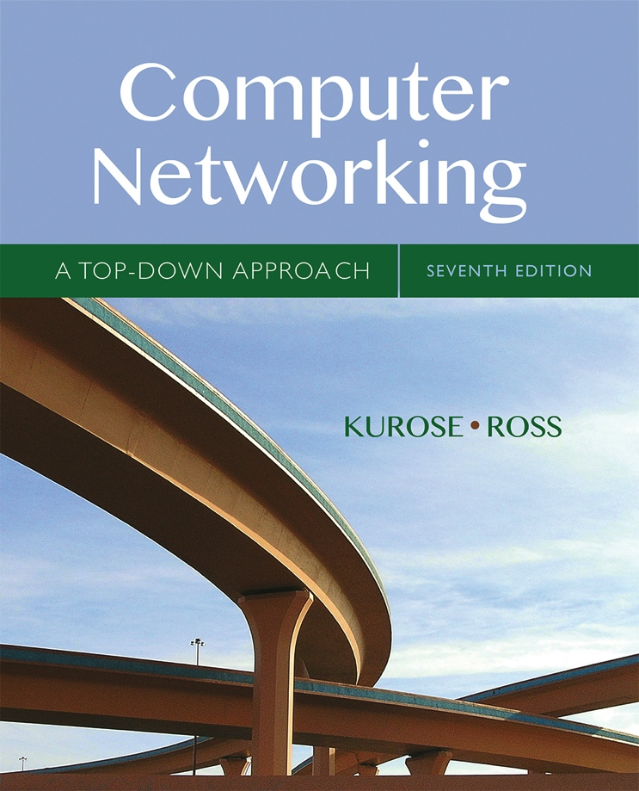


Chapter 5 Network Layer:
The Control Plane
A note on the use of these Powerpoint slides:
We’re making these slides freely available to all (faculty, students, readers). They’re in PowerPoint form so you see the animations; and can add, modify, and delete slides (including this one) and slide content to suit your needs. They obviously represent a lot of work on our part. In return for use, we only ask the following:
Computer Networking: A Top Down Approach
If you use these slides (e.g., in a class) that you mention their source (after all, we’d like people to use our book!)
If you post any slides on a www site, that you note that they are adapted from (or perhaps identical to) our slides, and note our copyright of this material.
Thanks and enjoy! JFK/KWR
All material copyright 1996-2016
J.F Kurose and K.W. Ross, All Rights Reserved
7th edition Jim Kurose, Keith Ross Pearson/Addison Wesley April 2016

Slide 2
Chapter 5: network layer control plane
chapter goals: understand principles behind network control plane
traditional routing algorithms
SDN controlllers
Internet Control Message Protocol
network management
and their instantiation, implementation in the Internet:
OSPF, BGP, OpenFlow, ODL and ONOS controllers, ICMP, SNMP

Slide 3
Chapter 5: outline
5.1 introduction
5.2 routing protocols
link state
distance vector
5.3 intra-AS routing in the Internet: OSPF
5.4 routing among the ISPs: BGP
5.5 The SDN control plane
5.6 ICMP: The Internet Control Message Protocol
5.7 Network management and SNMP

Slide 4
Network-layer functions
Recall: two network-layer functions:
forwarding: move packets from router’s input to appropriate router output
data plane
routing: determine route taken by packets from source to destination
control plane
Two approaches to structuring network control plane:
per-router control (traditional)
logically centralized control (software defined networking)

Slide 5

Per-router control plane
Individual routing algorithm components in each and every router interact with each other in control plane to compute forwarding tables
Routing
Algorithm
control
plane
data
plane

Slide 6
Logically centralized control plane
A distinct (typically remote) controller interacts with local control agents (CAs) in routers to compute forwarding tables
Remote Controller
control
plane
data
plane
CA
CA
CA
CA
CA

Slide 7
Chapter 5: outline
5.1 introduction
5.2 routing protocols
link state
distance vector
5.3 intra-AS routing in the Internet: OSPF
5.4 routing among the ISPs: BGP
5.5 The SDN control plane
5.6 ICMP: The Internet Control Message Protocol
5.7 Network management and SNMP

Slide 8
Routing protocols
Routing protocol goal: determine “good” paths (equivalently, routes), from sending hosts to receiving host, through network of routers
path: sequence of routers packets will traverse in going from given initial source host to given final destination host
“good”: least “cost”, “fastest”, “least congested”
routing: a “top-10” networking challenge!

Slide 9
Graph abstraction of the network
5
v
3
w
2
5
u
2
1
z
3
1
2
x
y
1
graph: G = (N,E)
N = set of routers = { u, v, w, x, y, z }
E = set of links ={ (u,v), (u,x), (v,x), (v,w), (x,w), (x,y), (w,y), (w,z), (y,z) }
aside: graph abstraction is useful in other network contexts, e.g.,
P2P, where N is set of peers and E is set of TCP connections

Slide 10
Graph abstraction: costs
5
c(x,x’) = cost of link (x,x’)
e.g., c(w,z) = 5
cost could always be 1, or
inversely related to bandwidth,
or inversely related to
congestion
v
3
w
2
5
u
2
1
z
3
1
2
x
y
1
cost of path (x₁, x₂, x₃,…, x_{p}) = c(x₁,x₂) + c(x₂,x₃) + … + c(x_{p-1},x_{p})
key question: what is the least-cost path between u and z ?
routing algorithm: algorithm that finds that least cost path

Slide 11
Routing algorithm classification
Q: global or decentralized information?
global:
all routers have complete topology, link cost info
“link state” algorithms
decentralized:
router knows physically-connected neighbors, link costs to neighbors
iterative process of computation, exchange of info with neighbors
“distance vector” algorithms
Q: static or dynamic?
static:
routes change slowly over time
dynamic:
routes change more quickly
periodic update
in response to link cost changes

Slide 12
Chapter 5: outline
5.1 introduction
5.2 routing protocols
link state
distance vector
5.3 intra-AS routing in the Internet: OSPF
5.4 routing among the ISPs: BGP
5.5 The SDN control plane
5.6 ICMP: The Internet Control Message Protocol
5.7 Network management and SNMP

Slide 13
A link-state routing algorithm
Dijkstra’s algorithm
net topology, link costs known to all nodes
accomplished via “link state broadcast”
all nodes have same info
computes least cost paths from one node (‘source”) to all other nodes
gives forwarding table for that node
iterative: after k iterations, know least cost path to k dest.’s
notation:
c(x,y): link cost from node x to y; = ∞ if not direct neighbors
D(v): current value of cost of path from source to dest. v
p(v): predecessor（前继） node along path from source to v
N': set of nodes whose least cost path definitively known

Slide 14
Dijsktra’s algorithm
1 Initialization:
2 N' = {u}
3 for all nodes v
4 if v adjacent to u
5 then D(v) = c(u,v)
6 else D(v) = ∞
7
8 Loop
9 find w not in N' such that D(w) is a minimum
10 add w to N'
11 update D(v) for all v adjacent to w and not in N' :
12 D(v) = min( D(v), D(w) + c(w,v) )
13 /* new cost to v is either old cost to v or known
14 shortest path cost to w plus cost from w to v */
15 until all nodes in N'

Slide 15
Dijkstra’s algorithm: example
D(v)
p(v)
D(w)
p(w)
D(x)
p(x)
D(y)
p(y)
D(z)
p(z)
Step
N'
0
u
7,u
3,u
5,u
∞
∞
1
uw
6,w
5,u
11,w
∞
2
uwx
6,w
11,w
14,x
3
uwxv
10,v
14,x
4
uwxvy
12,y
5
uwxvyz
x
9
notes:
construct shortest path tree by tracing predecessor nodes
ties can exist (can be broken arbitrarily)
5
7
4
8
u
3
w
y
z
2
3
7
4
v

Slide 16
Dijkstra’s algorithm: another example
Step
0
1
2
3
4
5
N'
u
ux
uxy
uxyv
uxyvw
uxyvwz
D(v),p(v)
2,u
2,u
2,u
D(w),p(w)
5,u
4,x
3,y
3,y
D(x),p(x)
1,u
D(y),p(y)
∞
2,x
D(z),p(z)
∞
∞
4,y
4,y
4,y
5
v
3
w
2
5
u
2
1
z
3
1
2
x
y
1
* Check out the online interactive exercises for more examples: http://gaia.cs.umass.edu/kurose_ross/interactive/

Slide 17
Dijkstra’s algorithm: example (2)
resulting shortest-path tree from u:
v
w
u
z
x
y
resulting forwarding table in u:
destination
link
v
(u,v)
x
(u,x)
y
(u,x)
w
(u,x)
z
(u,x)

Slide 18
Dijkstra’s algorithm, discussion
algorithm complexity: n nodes
each iteration: need to check all nodes, w, not in N
n(n+1)/2 comparisons: O(n²)
more efficient implementations possible: O(nlogn)
oscillations（震荡） possible:
e.g., support link cost equals amount of carried traffic:
A
A
A
A
1
1+e
2+e
0
0
2+e
2+e
0
D
B
D
B
D
B
D
B
0
0
1+e
1
0
0
1+e
1
0
C
e
0
0
1
0
0
1
C
C
1+e
C
1
e
initially
given these costs,
find new routing….
resulting in new costs
given these costs,
find new routing….
resulting in new costs
given these costs,
find new routing….
resulting in new costs
Notes:
（n-1）+ （n-2）+…+ 2 + 1 = n * (n-1)/2?
n，n-1，n-2，。。。。1=、n*（n+1）/2

Slide 19
Chapter 5: outline
5.1 introduction
5.2 routing protocols
link state
distance vector
5.3 intra-AS routing in the Internet: OSPF
5.4 routing among the ISPs: BGP
5.5 The SDN control plane
5.6 ICMP: The Internet Control Message Protocol
5.7 Network management and SNMP

Slide 20
Distance vector algorithm
Bellman-Ford equation (dynamic programming，动态规划)
let·
d_{x}(y) := cost of least-cost path from x to y
then
d_{x}(y) = min {c(x,v) + d_{v}(y) }
v
cost from neighbor v to destination y
cost to neighbor v
min taken over all neighbors v of x

Slide 21
Bellman-Ford example
5
clearly, d_{v}(z) = 5, d_{x}(z) = 3, d_{w}(z) = 3
v
3
w
2
5
u
z
B-F equation says:
2
1
3
1
2
d_{u}(z) = min { c(u,v) + d_{v}(z),
c(u,x) + d_{x}(z),
c(u,w) + d_{w}(z) }
= min {2 + 5,
1 + 3,
5 + 3} = 4
x
y
1
node achieving minimum is next
hop in shortest path, used in forwarding table

Slide 22
Distance vector algorithm
D_{x}(y) = estimate of least cost from x to y
x maintains distance vector D_{x} = [D_{x}(y): y є N ]
node x:
knows cost to each neighbor v: c(x,v)
maintains its neighbors’ distance vectors. For each neighbor v, x maintains D_{v} = [D_{v}(y): y є N ]

Slide 23
Distance vector algorithm
key idea:
from time-to-time, each node sends its own distance vector estimate to neighbors
when x receives new DV estimate from neighbor, it updates its own DV using B-F equation:
D_{x}(y) ← min_{v}{c(x,v) + D_{v}(y)} for each node y ∊ N
under minor, natural conditions, the estimate D_{x}(y) converge to the actual least cost d_{x}(y)

Slide 24
Distance vector algorithm
iterative, asynchronous: each local iteration caused by:
local link cost change
DV update message from neighbor
distributed:
each node notifies neighbors only when its DV changes
neighbors then notify their neighbors if necessary
each node:
wait for (change in local link cost or msg from neighbor)
recompute estimates
if DV to any dest has changed, notify neighbors

Slide 25
D_{x}(z) = min{c(x,y) + D_{y}(z), c(x,z) + D_{z}(z)}
= min{2+1 , 7+0} = 3
D_{x}(y) = min{c(x,y) + D_{y}(y), c(x,z) + D_{z}(y)} = min{2+0 , 7+1} = 2
node x
table
cost to
cost to
x y z
x y z
x
0 2 7
x
0
2
3
y
y
2 0 1
from
∞
∞
∞
from
z
∞
∞
∞
z
7 1 0
node y
table
cost to
x y z
y
2
1
x
∞
∞
z
∞
2 0 1
x
from
y
7
z
∞
∞
∞
node z
table
cost to
x y z
x
∞ ∞ ∞
from
y
∞
∞
∞
z
7
1
0
time

Slide 26
D_{x}(z) = min{c(x,y) + D_{y}(z), c(x,z) + D_{z}(z)}
= min{2+1 , 7+0} = 3
D_{x}(y) = min{c(x,y) + D_{y}(y), c(x,z) + D_{z}(y)} = min{2+0 , 7+1} = 2
node x
table
cost to
cost to
cost to
x y z
x y z
x y z
x
0 2 7
x
0
2
3
x
0 2 3
y
y
2 0 1
from
∞
∞
∞
from
y
2 0 1
z
z
from
∞
∞
∞
7 1 0
z
3 1 0
node y
table
cost to
cost to
cost to
x y z
x y z
x y z
y
2
1
x
∞
∞
x
0 2 7
∞
2 0 1
x
0 2 3
x
z
from
y
y
2 0 1
y
7
from
from
2 0 1
z
∞
∞
∞
z
7 1 0
z
3 1 0
node z
table
cost to
cost to
cost to
x y z
x y z
x y z
x
∞ ∞ ∞
x
0 2 7
x
0 2 3
y
y
2 0 1
from
y
∞
∞
from
2 0 1
from
∞
z
z
3 1 0
z
3 1 0
7
1
0
time
time

Slide 27
Distance vector: link cost changes
link cost changes:
node detects local link cost change
updates routing info, recalculates distance vector
if DV changes, notify neighbors
1
y
4
1
x
z
50
“good
news
travels
fast”
t₀ : y detects link-cost change, updates its DV, informs its neighbors. 从4变为1
t₁ : z receives update from y, updates its table, computes new least cost to x , sends its neighbors its DV. 开销从5变为2
t₂ : y receives z’s update, updates its distance table. y’s least costs do not change, so y does not send a message to z. y不变了，还是1
* Check out the online interactive exercises for more examples: http://gaia.cs.umass.edu/kurose_ross/interactive/

Slide 28
Distance vector: link cost changes
link cost changes:
node detects local link cost change
bad news travels slow - “count to infinity” problem!
44 iterations before algorithm stabilizes: see text
路由选择环路
60
y
4
1
x
z
50
D_{y}（x）=min{c(y,x)+Dx(x), c(y,z)+Dz(x)}
=min{60+0,1+5}=6
poisoned reverse: （增加毒性逆转）
If Z routes through Y to get to X :
Z tells Y its (Z’s) distance to X is infinite (so Y won’t route to X via Z)
will this completely solve count to infinity problem?

Slide 29
Comparison of LS and DV algorithms
message complexity
LS: with n nodes, E links, O(nE) msgs sent
DV: exchange between neighbors only
convergence time varies
speed of convergence
LS: O(n²) algorithm requires O(nE) msgs
may have oscillations
DV: convergence time varies
may be routing loops
count-to-infinity problem
robustness: what happens if router malfunctions?
LS:
node can advertise incorrect link cost
each node computes only its own table
DV:
DV node can advertise incorrect path cost
each node’s table used by others
error propagate thru network

Slide 30
Chapter 5: outline
5.1 introduction
5.2 routing protocols
link state
distance vector
5.3 intra-AS routing in the Internet: OSPF
5.4 routing among the ISPs: BGP
5.5 The SDN control plane
5.6 ICMP: The Internet Control Message Protocol
5.7 Network management and SNMP

Slide 31
Making routing scalable
our routing study thus far - idealized
all routers identical
network “flat”
… not true in practice
scale: with billions of destinations:
can’t store all destinations in routing tables!
routing table exchange would swamp links!
administrative autonomy
internet = network of networks
each network admin may want to control routing in its own network

Slide 32
Internet approach to scalable routing
aggregate routers into regions known as “autonomous systems” (AS) (a.k.a. “domains”)
intra-AS routing
routing among hosts, routers in same AS (“network”)
all routers in AS must run same intra-domain protocol
routers in different AS can run different intra-domain routing protocol
gateway router: at “edge” of its own AS, has link(s) to router(s) in other AS’es
inter-AS routing
routing among AS’es
gateways perform inter-domain routing (as well as intra-domain routing)

Slide 33
Inter-AS tasks
suppose router in AS1 receives datagram destined outside of AS1:
router should forward packet to gateway router, but which one?
AS1 must:
learn which dests are reachable through AS2, which through AS3
propagate this reachability info to all routers in AS1
job of inter-AS routing!
3c
3a
3b
AS3
2c
other
networks
1c
2a
other
networks
1a
2b
1b
AS2
AS1
1d

Slide 34
Interconnected ASes
3c
3a
2c
3b
AS3
2a
1c
2b
AS2
1a
1b
1d
AS1
forwarding table configured by both intra- and inter-AS routing algorithm
intra-AS routing determine entries for destinations within AS
inter-AS & intra-AS determine entries for external destinations
Intra-AS
Routing
algorithm
Inter-AS
Routing
algorithm
Forwarding
table

Slide 35
Intra-AS Routing
also known as interior gateway protocols (IGP)
most common intra-AS routing protocols:
RIP: Routing Information Protocol
OSPF: Open Shortest Path First (IS-IS protocol essentially same as OSPF)
IGRP: Interior Gateway Routing Protocol (Cisco proprietary for decades, until 2016)

Slide 36
OSPF (Open Shortest Path First) 开放最短路径优先
“open”: publicly available
uses link-state algorithm
link state packet dissemination
topology map at each node
route computation using Dijkstra’s algorithm
router floods OSPF link-state advertisements to all other routers in entire AS
carried in OSPF messages directly over IP (rather than TCP or UDP
link state: for each attached link
IS-IS routing protocol: nearly identical to OSPF

Slide 37
OSPF “advanced” features
security: all OSPF messages authenticated (to prevent malicious intrusion)
multiple same-cost paths allowed (only one path in RIP) ，多条相同开销的路径
for each link, multiple cost metrics for different TOS (e.g., satellite link cost set low for best effort ToS; high for real-time ToS)
integrated uni- and multi-cast support: 单播和多播的支持
Multicast OSPF (MOSPF) uses same topology data base as OSPF
hierarchical OSPF in large domains.

Slide 38
Hierarchical OSPF
boundary router
backbone router
backbone
area
border
routers
area 3
internal
routers
area 1
area 2

Slide 39
Hierarchical OSPF
two-level hierarchy: local area, backbone.
link-state advertisements only in area
each nodes has detailed area topology; only know direction (shortest path) to nets in other areas.
area border routers: “summarize” distances to nets in own area, advertise to other Area Border routers.
backbone routers: run OSPF routing limited to backbone.
boundary routers: connect to other AS’es.

Slide 40
Chapter 5: outline
5.1 introduction
5.2 routing protocols
link state
distance vector
5.3 intra-AS routing in the Internet: OSPF
5.4 routing among the ISPs: BGP
5.5 The SDN control plane
5.6 ICMP: The Internet Control Message Protocol
5.7 Network management and SNMP

Slide 41
Internet inter-AS routing: BGP
BGP (Border Gateway Protocol): the de facto inter-domain routing protocol 边界网关协议
“glue that holds the Internet together”
BGP provides each AS a means to:
eBGP: obtain subnet reachability information from neighboring ASes
iBGP: propagate reachability information to all AS-internal routers.
determine “good” routes to other networks based on reachability information and policy
allows subnet to advertise its existence to rest of Internet: “I am here”

Slide 42
eBGP, iBGP connections
2b
∂
2a
2c
1b
3b
2d
∂
1a
1c
3a
3c
AS 2
1d
3d
AS 1
eBGP connectivity
AS 3
iBGP connectivity
1c
gateway routers run both eBGP and iBGP protools

Slide 43
BGP basics
BGP session: two BGP routers (“peers”) exchange BGP messages over semi-permanent TCP connection:
advertising paths to different destination network prefixes (BGP is a “path vector” protocol)
when AS3 gateway router 3a advertises path AS3,X to AS2 gateway router 2c:
AS3 promises to AS2 it will forward datagrams towards X
AS 3
3b
AS 1
1b
3a
3c
1a
1c
AS 2
2b
3d
X
1d
2a
2c
BGP advertisement:
AS3, X
2d

Slide 44
Path attributes and BGP routes
advertised prefix includes BGP attributes
prefix + attributes = “route”
two important attributes:
AS-PATH: list of ASes through which prefix advertisement has passed
NEXT-HOP: indicates specific internal-AS router to next-hop AS
Policy-based routing:
gateway receiving route advertisement uses import policy to accept/decline path (e.g., never route through AS Y).
AS policy also determines whether to advertise path to other other neighboring ASes

Slide 45
BGP path advertisement
AS3
3b
AS1
1b
3a
3c
1a
1c
AS2
2b
3d
X
1d
AS3,X
AS2,AS3,X
2a
2c
2d
AS2 router 2c receives path advertisement AS3,X (via eBGP) from AS3 router 3a
Based on AS2 policy, AS2 router 2c accepts path AS3,X, propagates (via iBGP) to all AS2 routers
Based on AS2 policy, AS2 router 2a advertises (via eBGP) path AS2, AS3, X to AS1 router 1c

Slide 46
BGP path advertisement
AS3
3b
AS1
1b
AS3,X
3a
3c
1a
1c
AS2
2b
3d
X
1d
AS3,X
AS2,AS3,X
2a
2c
2d
gateway router may learn about multiple paths to destination:
AS1 gateway router 1c learns path AS2,AS3,X from 2a
AS1 gateway router 1c learns path AS3,X from 3a
Based on policy, AS1 gateway router 1c chooses path AS3,X, and advertises path within AS1 via iBGP

Slide 47
BGP messages
BGP messages exchanged between peers over TCP connection
BGP messages:
OPEN: opens TCP connection to remote BGP peer and authenticates sending BGP peer
UPDATE: advertises new path (or withdraws old)
KEEPALIVE: keeps connection alive in absence of UPDATES; also ACKs OPEN request
NOTIFICATION: reports errors in previous msg; also used to close connection

Slide 48
BGP, OSPF, forwarding table entries
Q: how does router set forwarding table entry to distant prefix?
AS3
3b
AS1
1b
AS3,X
1
AS3,X
3a
3c
1a
2
1c
local link interfaces
at 1a, 1d
AS2
2b
3d
X
2
1d
1
AS3,X
AS2,AS3,X
2a
2c
physical link
2d
dest
interface
recall: 1a, 1b, 1c learn about dest X via iBGP from 1c: “path to X goes through 1c”
…
…
…
…
X
1
1d: OSPF intra-domain routing: to get to 1c, forward over outgoing local interface 1

Slide 49
BGP, OSPF, forwarding table entries
Q: how does router set forwarding table entry to distant prefix?
AS3
3b
AS1
1b
1
3a
3c
1a
2
1c
AS2
2b
3d
X
1d
2a
2c
2d
dest
interface
recall: 1a, 1b, 1c learn about dest X via iBGP from 1c: “path to X goes through 1c”
…
…
…
…
X
2
1d: OSPF intra-domain routing: to get to 1c, forward over outgoing local interface 1
1a: OSPF intra-domain routing: to get to 1c, forward over outgoing local interface 2

Slide 50
BGP route selection
router may learn about more than one route to destination AS, selects route based on:
local preference value attribute: policy decision
shortest AS-PATH
closest NEXT-HOP router: hot potato routing
additional criteria

Slide 51
Hot Potato Routing
AS3
3b
AS1
1b
3a
3c
1a
1c
AS2
2b
3d
X
1d
112
152
AS3,X
AS1,AS3,X
2a
263
2c
201
OSPF link weights
2d
2d learns (via iBGP) it can route to X via 2a or 2c
hot potato routing: choose local gateway that has least intra-domain cost (e.g., 2d chooses 2a, even though more AS hops to X): don’t worry about inter-domain cost!

Slide 52
BGP: achieving policy via advertisements
legend:
provider
B
network
X
W
A
customer
C
network:
Y
Suppose an ISP only wants to route traffic to/from its customer networks (does not want to carry transit traffic between other ISPs)
A advertises path Aw to B and to C
B chooses not to advertise BAw to C:
B gets no “revenue” for routing CBAw, since none of C, A, w are B’s customers
C does not learn about CBAw path
C will route CAw (not using B) to get to w

Slide 53
BGP: achieving policy via advertisements
legend:
provider
B
network
X
W
A
customer
C
network:
Y
Suppose an ISP only wants to route traffic to/from its customer networks (does not want to carry transit traffic between other ISPs)
A,B,C are provider networks
X,W,Y are customer (of provider networks)
X is dual-homed: attached to two networks
policy to enforce: X does not want to route from B to C via X
.. so X will not advertise to B a route to C

Slide 54
Why different Intra-, Inter-AS routing ?
policy:
inter-AS: admin wants control over how its traffic routed, who routes through its net.
intra-AS: single admin, so no policy decisions needed
scale:
hierarchical routing saves table size, reduced update traffic
performance:
intra-AS: can focus on performance
inter-AS: policy may dominate over performance

Slide 55
Chapter 5: outline
5.1 introduction
5.2 routing protocols
link state
distance vector
5.3 intra-AS routing in the Internet: OSPF
5.4 routing among the ISPs: BGP
5.5 The SDN control plane
5.6 ICMP: The Internet Control Message Protocol
5.7 Network management and SNMP

Slide 56
Software defined networking (SDN)
Internet network layer: historically has been implemented via distributed, per-router approach
monolithic router contains switching hardware, runs proprietary implementation of Internet standard protocols (IP, RIP, IS-IS, OSPF, BGP) in proprietary router OS (e.g., Cisco IOS)
different “middleboxes” for different network layer functions: firewalls, load balancers, NAT boxes, ..
~2005: renewed interest in rethinking network control plane

Slide 57
Recall: per-router control plane
Individual routing algorithm components in each and every router interact with each other in control plane to compute forwarding tables
Routing
Algorithm
control
plane
data
plane

Slide 58
Recall: logically centralized control plane
A distinct (typically remote) controller interacts with local control agents (CAs) in routers to compute forwarding tables
Remote Controller
control
plane
data
plane
CA
CA
CA
CA
CA

Slide 59
Software defined networking (SDN)
Why a logically centralized control plane?
easier network management: avoid router misconfigurations, greater flexibility of traffic flows
table-based forwarding (recall OpenFlow API) allows “programming” routers
centralized “programming” easier: compute tables centrally and distribute
distributed “programming: more difficult: compute tables as result of distributed algorithm (protocol) implemented in each and every router
open (non-proprietary) implementation of control plane

Slide 60
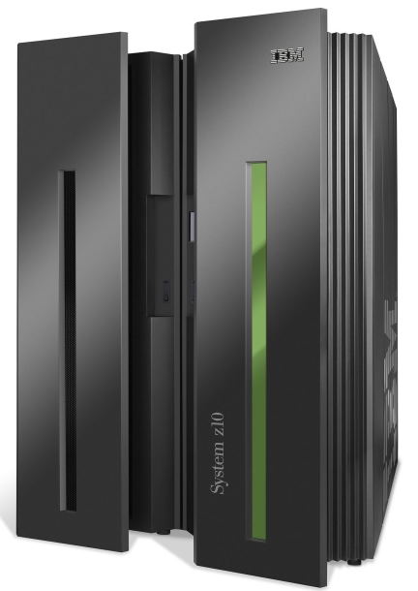
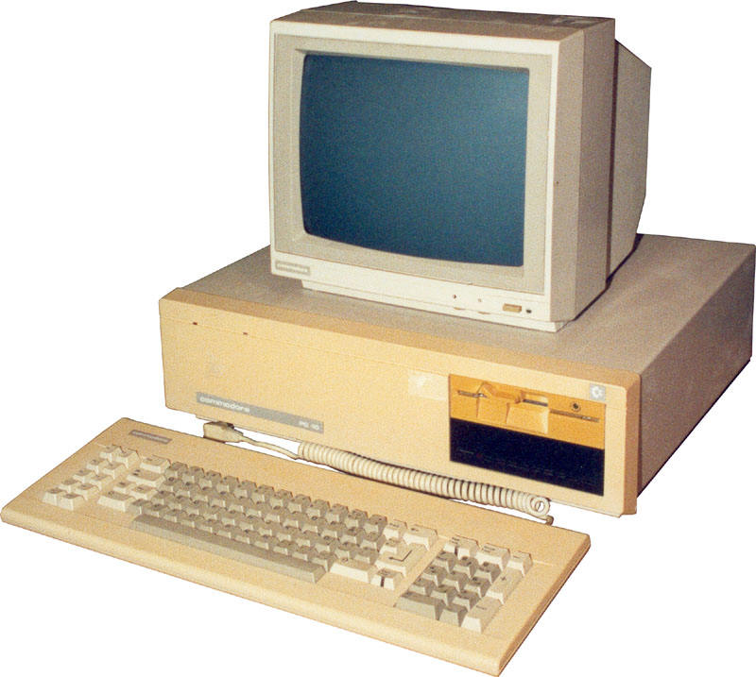
Analogy: mainframe to PC evolution*
App
App
App
App
App
App
App
App
App
App
App
Specialized
Applications
Open Interface
Specialized
Operating
System
Windows
(OS)
Linux
Mac
OS
or
or
Specialized
Hardware
Open Interface
Microprocessor
Vertically integrated
Closed, proprietary
Slow innovation
Small industry
Horizontal
Open interfaces
Rapid innovation
Huge industry
* Slide courtesy: N. McKeown

Slide 61

Traffic engineering: difficult traditional routing
5
3
v
w
5
2
u
2
1
z
3
1
2
x
y
1
Q: what if network operator wants u-to-z traffic to flow along uvwz, x-to-z traffic to flow xwyz?
A: need to define link weights so traffic routing algorithm computes routes accordingly (or need a new routing algorithm)!
Link weights are only control “knobs”: wrong!
Notes:
Note: implicit assumption here: destination based forwarding

Slide 62
Traffic engineering: difficult
5
3
v
w
5
2
u
2
1
z
3
1
2
x
y
1
Q: what if network operator wants to split u-to-z traffic along uvwz and uxyz (load balancing)?
A: can’t do it (or need a new routing algorithm)
Notes:
Note: implicit assumption here: destination based forwarding

Slide 63
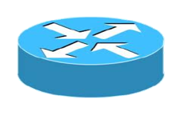
Traffic engineering: difficult
Networking 401
5
v
3
w
2
v
w
5
u
2
1
z
3
z
1
2
x
y
x
1
y
Q: what if w wants to route blue and red traffic differently?
A: can’t do it (with destination based forwarding, and LS, DV routing)
Notes:
Note: implicit assumption here: destination based forwarding

Slide 64
Software defined networking (SDN)
4. programmable control applications
…
3. control plane functions external to data-plane switches
routing
access control
load
balance
Remote Controller
control
plane
data
plane
CA
2. control, data plane separation
CA
CA
CA
CA
1: generalized“ flow-based” forwarding (e.g., OpenFlow)

Slide 65
SDN perspective: data plane switches
Data plane switches
fast, simple, commodity switches implementing generalized data-plane forwarding (Section 4.4) in hardware
switch flow table computed, installed by controller
API for table-based switch control (e.g., OpenFlow)
defines what is controllable and what is not
protocol for communicating with controller (e.g., OpenFlow)
network-control applications
…
routing
access
control
load
balance
control
plane
northbound API
SDN Controller
(network operating system)
southbound API
data
plane
SDN-controlled switches

Slide 66
SDN perspective: SDN controller
SDN controller (network OS):
maintain network state information
interacts with network control applications “above” via northbound API
interacts with network switches “below” via southbound API
implemented as distributed system for performance, scalability, fault-tolerance, robustness
network-control applications
…
routing
access
control
load
balance
control
plane
northbound API
SDN Controller
(network operating system)
southbound API
data
plane
SDN-controlled switches

Slide 67
SDN perspective: control applications
network-control apps:
“brains” of control: implement control functions using lower-level services, API provided by SND controller
unbundled: can be provided by 3rd party: distinct from routing vendor, or SDN controller
network-control applications
…
routing
access
control
load
balance
control
plane
northbound API
SDN Controller
(network operating system)
southbound API
data
plane
SDN-controlled switches

Slide 68
Components of SDN controller
routing
access
control
load
balance
Interface layer to network control apps: abstractions API
Interface, abstractions for network control apps
…
network graph
RESTful
API
intent
Network-wide state management layer: state of networks links, switches, services: a distributed database
…
statistics
flow tables
SDN
controller
Network-wide distributed, robust state management
…
Link-state info
host info
switch info
…
communication layer: communicate between SDN controller and controlled switches
OpenFlow
SNMP
Communication to/from controlled devices

Slide 69

OpenFlow protocol
operates between controller, switch
TCP used to exchange messages
optional encryption
three classes of OpenFlow messages:
controller-to-switch
asynchronous (switch to controller)
symmetric (misc)
OpenFlow Controller

Slide 70
OpenFlow: controller-to-switch messages
Key controller-to-switch messages
features: controller queries switch features, switch replies
configure: controller queries/sets switch configuration parameters
modify-state: add, delete, modify flow entries in the OpenFlow tables
packet-out: controller can send this packet out of specific switch port
OpenFlow Controller

Slide 71
OpenFlow: switch-to-controller messages
Key switch-to-controller messages
packet-in: transfer packet (and its control) to controller. See packet-out message from controller
flow-removed: flow table entry deleted at switch
port status: inform controller of a change on a port.
OpenFlow Controller
Fortunately, network operators don’t “program” switches by creating/sending OpenFlow messages directly. Instead use higher-level abstraction at controller

Slide 72
SDN: control/data plane interaction example
Dijkstra’s link-state
Routing
1
S1, experiencing link failure using OpenFlow port status message to notify controller
4
5
…
network graph
RESTful
API
intent
2
SDN controller receives OpenFlow message, updates link status info
3
…
statistics
flow tables
…
3
Dijkstra’s routing algorithm application has previously registered to be called when ever link status changes. It is called.
Link-state info
host info
switch info
2
…
OpenFlow
SNMP
6
4
Dijkstra’s routing algorithm access network graph info, link state info in controller, computes new routes
1
s2
s1
s4
s3

Slide 73
SDN: control/data plane interaction example
Dijkstra’s link-state
Routing
4
5
…
network graph
RESTful
API
intent
5
link state routing app interacts with flow-table-computation component in SDN controller, which computes new flow tables needed
3
…
statistics
flow tables
…
Link-state info
host info
switch info
2
…
6
Controller uses OpenFlow to install new tables in switches that need updating
OpenFlow
SNMP
6
1
s2
s1
s4
s3

Slide 74
OpenDaylight (ODL) controller
…
Traffic
Engineering
ODL Lithium controller
network apps may be contained within, or be external to SDN controller
Service Abstraction Layer: interconnects internal, external applications and services
REST API
Network service apps
Basic Network Service Functions
topology
manager
switch
manager
stats
manager
Access
Control
forwarding
manager
host
manager
Service Abstraction Layer (SAL)
…
OpenFlow 1.0
SNMP
OVSDB

Slide 75
ONOS controller
…
Network
control apps
control apps separate from controller
intent framework: high-level specification of service: what rather than how
considerable emphasis on distributed core: service reliability, replication performance scaling
northbound abstractions,
protocols
REST API
Intent
hosts
paths
flow rules
topology
ONOS
distributed core
devices
links
statistics
device
link
host
flow
packet
southbound abstractions,
protocols
OpenFlow
Netconf
OVSDB

Slide 76
SDN: selected challenges
hardening the control plane: dependable, reliable, performance-scalable, secure distributed system
robustness to failures: leverage strong theory of reliable distributed system for control plane
dependability, security: “baked in” from day one?
networks, protocols meeting mission-specific requirements
e.g., real-time, ultra-reliable, ultra-secure
Internet-scaling

Slide 77
Chapter 5: outline
5.1 introduction
5.2 routing protocols
link state
distance vector
5.3 intra-AS routing in the Internet: OSPF
5.4 routing among the ISPs: BGP
5.5 The SDN control plane
5.6 ICMP: The Internet Control Message Protocol
5.7 Network management and SNMP

Slide 78
ICMP: internet control message protocol 控制报文协议
used by hosts & routers to communicate network-level information
error reporting: unreachable host, network, port, protocol
echo request/reply (used by ping)
network-layer “above” IP:
ICMP msgs carried in IP datagrams
ICMP message: type, code plus first 8 bytes of IP datagram causing error
Type Code description
0 0 echo reply (ping)
3 0 dest. network unreachable
3 1 dest host unreachable
3 2 dest protocol unreachable
3 3 dest port unreachable
3 6 dest network unknown
3 7 dest host unknown
4 0 source quench (congestion
control - not used)
8 0 echo request (ping)
9 0 route advertisement
10 0 router discovery
11 0 TTL expired
12 0 bad IP header

Slide 79

Traceroute and ICMP
source sends series of UDP segments to destination
first set has TTL =1
second set has TTL=2, etc.
unlikely port number
when datagram in nth set arrives to nth router:
router discards datagram and sends source ICMP message (type 11, code 0)
ICMP message include name of router & IP address
when ICMP message arrives, source records RTTs
stopping criteria:
UDP segment eventually arrives at destination host
destination returns ICMP “port unreachable” message (type 3, code 3)
source stops
3 probes
3 probes
3 probes

Slide 80
Chapter 5: outline
5.1 introduction
5.2 routing protocols
link state
distance vector
5.3 intra-AS routing in the Internet: OSPF
5.4 routing among the ISPs: BGP
5.5 The SDN control plane
5.6 ICMP: The Internet Control Message Protocol
5.7 Network management and SNMP

Slide 81
What is network management?
autonomous systems (aka “network”): 1000s of interacting hardware/software components
other complex systems requiring monitoring, control:
jet airplane
nuclear power plant
others?
"Network management includes the deployment, integration
and coordination of the hardware, software, and human
elements to monitor, test, poll, configure, analyze, evaluate,
and control the network and element resources to meet the
real-time, operational performance, and Quality of Service
requirements at a reasonable cost."

Slide 82


Infrastructure for network management
definitions:
网络管理代理
managing entity
agent
data
managing
entity
managed devices contain managed objects whose data is gathered into a Management Information Base (MIB)
data
managed device
network
management
protocol
agent
data
managed device
agent
data
managed device
agent
data
agent
data
managed device
managed device

Slide 83
SNMP protocol
Two ways to convey MIB info, commands:
管理服务器
managing
entity
managing
entity
request
trap msg
response
agent
data
agent
data
managed device
managed device
request/response mode
trap mode

Slide 84
SNMP protocol: message types
Message type
Function
GetRequest
GetNextRequest
GetBulkRequest
manager-to-agent: “get me data”
(data instance, next data in list, block of data)
InformRequest
manager-to-manager: here’s MIB value
SetRequest
manager-to-agent: set MIB value
Response
Agent-to-manager: value, response to
Request
Trap
Agent-to-manager: inform manager
of exceptional event

Slide 85
SNMP protocol: message formats
Get/set header
Variables to get/set
PDU
type
(0-3)
Error
Status
(0-5)
Request
ID
Error
Index
Name
Value
Name
Value
….
PDU
type
4
Trap
Type
(0-7)
Enterprise
Agent
Addr
Specific
code
Time
stamp
Name
Value
….
Trap header
Trap info
SNMP PDU
More on network management: see earlier editions of text!

Slide 86
Chapter 5: summary
we’ve learned a lot!
approaches to network control plane
per-router control (traditional)
logically centralized control (software defined networking)
traditional routing algorithms
implementation in Internet: OSPF, BGP
SDN controllers
implementation in practice: ODL, ONOS
Internet Control Message Protocol
network management
next stop: link layer!

